Slide 1

HEY!
We are sophomores from Amrita Vishwa Vidyapeetham. Today we are here to create an awareness and present regarding :
SUBSTANCE ABUSE

Slide 2
Here we go!!
Let’s start with a small quiz ;) ;)

Slide 3
Your 1st question :)
what do you think can be the reasons for substance abuse among youth?

Slide 4
2nd
question :)
what will you do if you encounter a person(say your friend) suffering from substance abuse?

Slide 5
3rd
question :)
What is your greatest fear what will you do to overcome it?

Slide 6
4th
question :)
Will substance abuse leads to the backwardness of the country(yes or no)? if yes in what ways?

Slide 7
5th question :)
If you have a chance will you participate in campaigns that spread awareness in substance abuse?

Slide 8
INTRO ABOUT SUBSTANCE ABUSE
Substance abuse has been a social problem in various forms for many centuries. Kerala shows a high prevalence in alcoholism and is ranked top in India. This study is aimed at finding the prevalence and determinants of substance abuse among youth in the central part of Kerala in South India. Substance abuse refers to the harmful or hazardous use of psychoactive substances, including alcohol and illicit drugs.

Slide 9
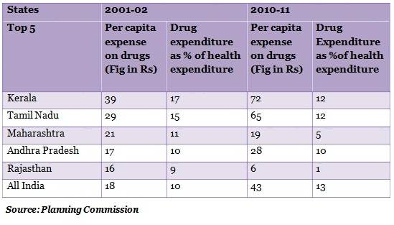
STATISTICS:

Slide 10
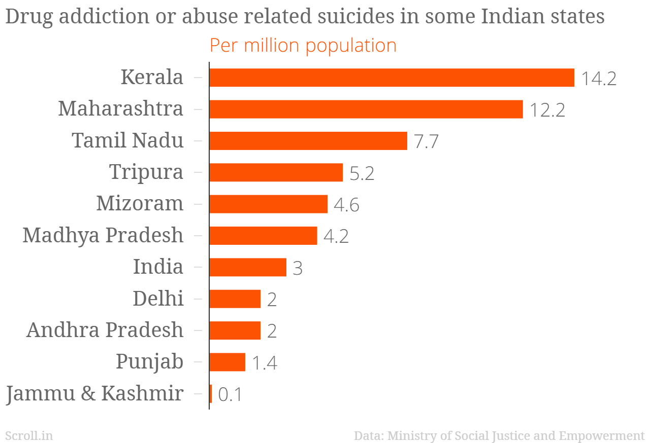
Recent Statistics

Slide 11
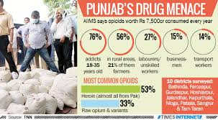
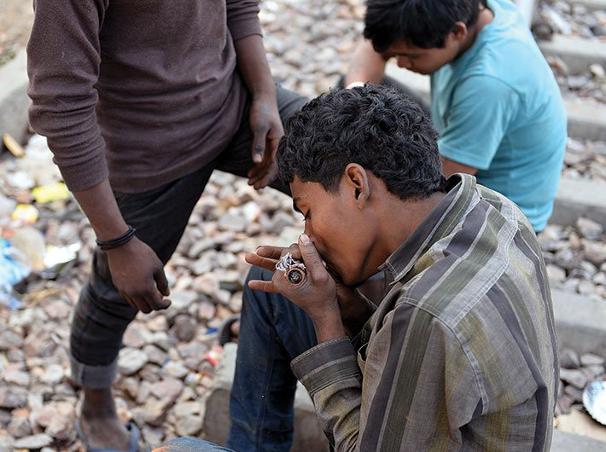
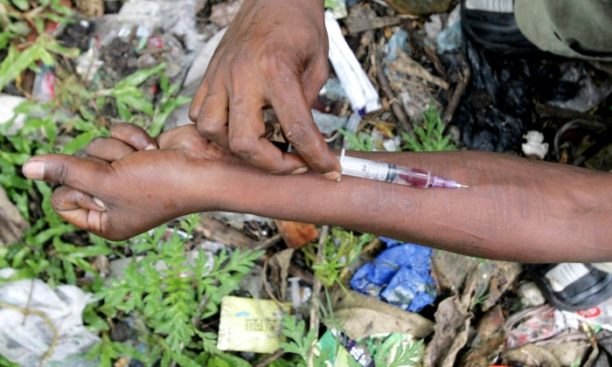

Slide 12
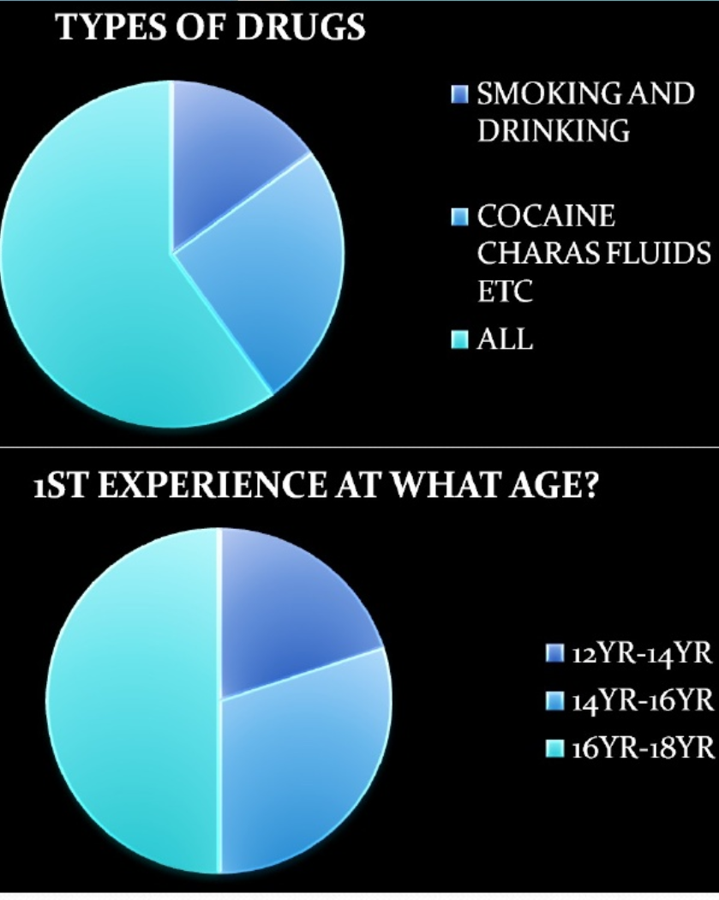

Slide 13
IT’S HIGH NOW !!
To bring out the attention of you let’s have a small interactive session :)

Slide 14
A small chit will be given and your task is to write…
What is your fear??

Slide 15
Relatable
VIDEOS
video -1(effects of drug over usage)
video-2(motivational video of rdj)

Slide 16
REASONS:
1.EXPERIMENTING
It is not uncommon for addiction to stem from a person being curious and experimenting with drugs or alcohol. It is a scenario that often starts with a young person using alcohol or marijuana out of curiosity.
2.LONELINESS
Addiction can start when an individual feels lonely or is isolated from the friends and family. They turn to drugs and alcohol thinking that it will fill a void that they have been living with.
3.PRESCRIPTION DRUGS
There is a popular misconception that any medication prescribed by a doctor is safe. Unfortunately, that is not always the case. Doctors prescribe medications to alleviate symptoms of physical or mental health issues.

Slide 17
SOME MORE:
4. FAMILY HISTORY/GENETICS
If you have a family history of drug addiction, you may have a genetic predisposition to develop an addiction to drugs or alcohol.
5. DRUGS AND ALCOHOL CAN MAKE YOU FEEL GOOD
While this seems obvious, some people like the effect so much that they are unable to stop. It may be difficult to see the harm in something that makes you feel good.
6.RECREATION
Many people use drugs or alcohol socially with friends or to “unwind” after a long day. They often see substances as a way to relax or clear their minds. Recreational drug users are still at risk to become addicted if their use becomes more frequent or they use highly addictive substances.

Slide 18
Effects:
Effect on brain:
Judgement
Decision making
Memory
Ability to learn
You may have one or more of these Effects:
An urge to use the drug every day, or many times a day.
You take more drugs than you want to, and for longer than you thought you would.
You always have the drug with you, and you buy it even if you can’t afford it.
You keep using drugs even if it causes you trouble at work or makes you lash out at family and friends.
You spend more time alone.
You don’t take care of yourself or care how you look.
You steal, lie, or do dangerous things like driving while high or have unsafe sex.
You spend most of your time getting, using, or recovering from the effects of the drug.
You feel sick when you try to quit.

Slide 19
PRECAUTIONS:
1 : Find new hobbies
2 : Exercise
3 : Volunteer
4 : Eat well
5: Talk it out
6 : Meditate
7: Seek professional help

Slide 20
NOW IT’S TIME FOR YOU ;)
Create a small posture which represents/symbolises substance abuse.

Slide 21
THANKS!
Any questions?

